Slide 1
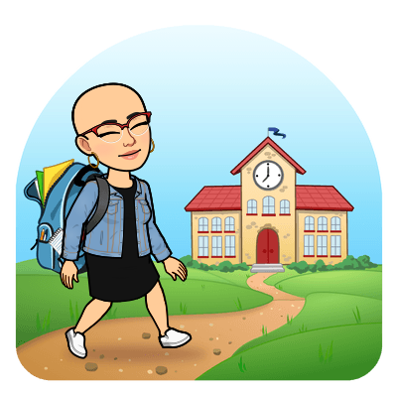
Family Engagement Centers In New Bedford Public Schools

Slide 2
I am your Family Engagement Specialist
Veronica Ortiz
You can find me in our Family Engagement Center

Slide 3
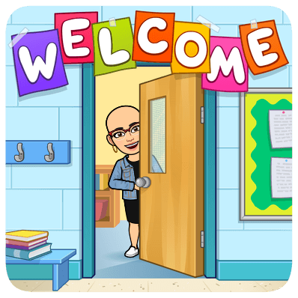
Monday, Wednesday, Thursday and Friday
8am-4pm
Tuesday
10am-6pm
Hours are subject to change

Slide 4
Contact Information
Email: vortiz@newbedfordschools.org
Phone Number:
508-997-4511 ex. 47518
Google Phone Number:
774-377-9706

Slide 5
What Are Family Engagement Centers?
Located within various schools in the district to empower and strengthen authentic home, school, and community relationships to ensure student success.
Collaborate with families to meet their needs in efforts to increase student academic and social achievements.
Collaborations with community-based organizations, local businesses, Parent-Teacher organizations, and district staff are the keys to the success of our centers.

Slide 6
What services do we provide?
Information
Childcare programs, workshops, support groups, career training, treatment programs, etc.
Lending Library
Books, pamphlets, videos, magazines, other media on parenting topics, health, safety, etc.
Family Fun
Fun activities for students, parents, and the community
Educational Support
Workshops scheduled on a variety of topics like job skill training, GED, or literacy programs
Student Needs
School supplies, clothing, etc.
Foster Relationships
Peer to peer, group to group, agency to agency, etc.
Resources and Referral Services
Parenting classes, mental health services, food, clothing, utility assistance, housing, etc.

Slide 7
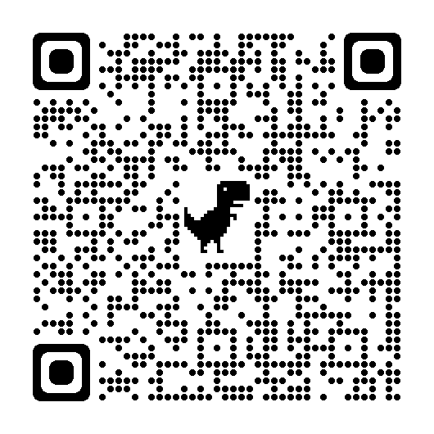
Who Can Refer Families?
All referral forms should be turned in to the Family Engagement Center, WAC, or FES.
Teachers
Administrators
School Staff
Community Providers
Families
Scan this QR code to make a referral

